Slide 1
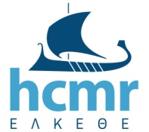
Hellenic Centre for Marine Research
Institute of Marine Biological Resources and Inland Waters
JRC-IRP No.937804
Lot 9 Landscape elements for water retention (LWR) in a Mediterranean environment
A Large-Scale Nature-Based Solution in Agriculture for Sustainable Water Management: The Lake Karla case
Ioannis Panagopoulos, Elias Dimitriou

Slide 2
Hellenic Centre for Marine Research
Institute of Marine Biological Resources and Inland Waters
Context and Case
Agriculture was responsible for 59% of total water use in 2017, mainly because of the extreme percentages in Southern Europe (EEA, 2019)
Water scarcity conditions and drought events continue to cause significant risks in southern Europe, where agriculture exerts the highest pressure on renewable freshwater resources (80% of total water use)
Nature-Based Solutions (NBSs) to collect, store and distribute water:
enhance the availability and quality of water for productive purposes and human consumption
preserve the integrity and intrinsic value of the ecosystems
provide environmental, social and economic benefits and help build resilience
provide solutions for the benefit of societies and overall biodiversity.
https://en.wikipedia.org/wiki/Nature-based_solutions

Slide 3
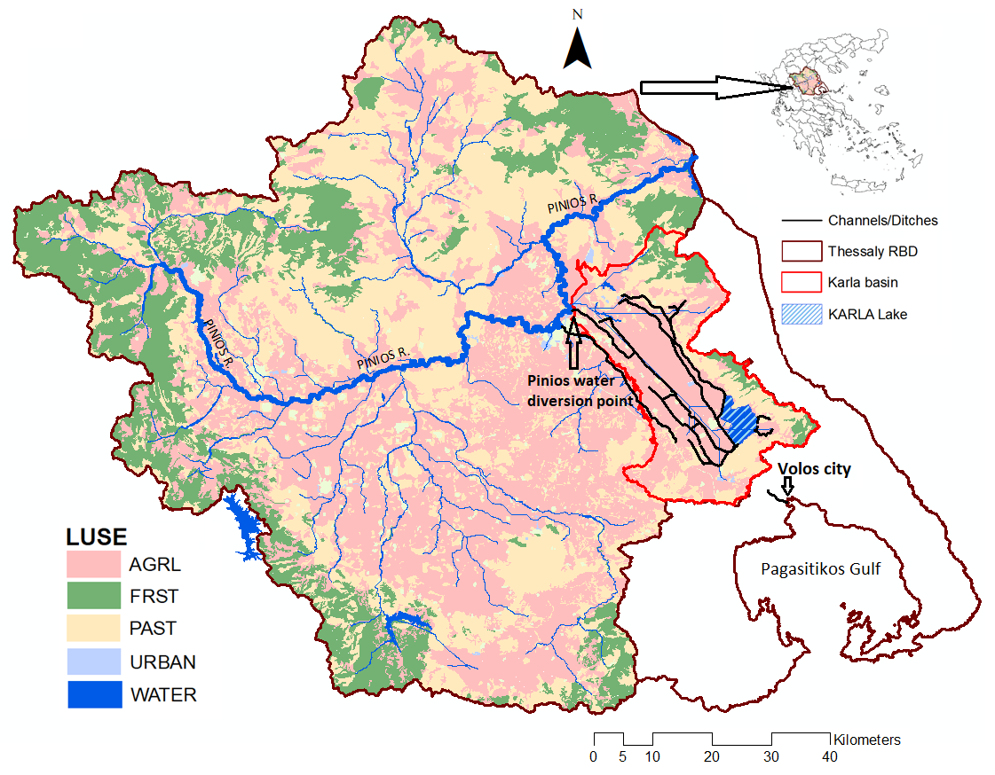
Hellenic Centre for Marine Research
Institute of Marine Biological Resources and Inland Waters
Lake Karla NBS
Karla is a newly created reservoir within the Karla basin, a subbasin of Pinios river basin
It is a unique example at European scale of a lake ecosystem which was dried and restored
The area around is important for agriculture with fertile land but dry summers, resulting in irrigation cutbacks, overexploitation of groundwater and significant losses of crop yields
Irrigated cotton remains the engine of the local agricultural economy

Slide 4
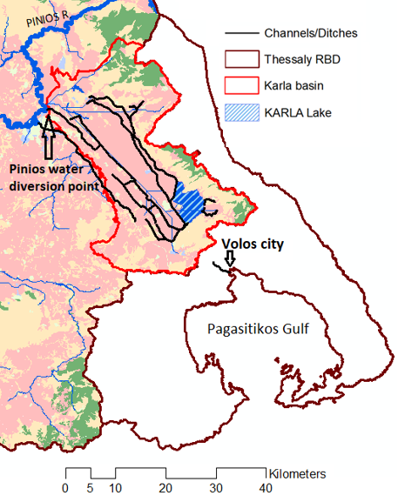
Hellenic Centre for Marine Research
Institute of Marine Biological Resources and Inland Waters
Historical Developments of Lake Karla
A natural lake until 1962 (40-180 km²)
important ecosystem, a ‘‘hot-spot’’ of biodiversity
natural reservoir providing water storage and recharge to groundwater
Dried in 1962 due to the need for agricultural land and human diseases associated with wetlands. Consequences:
Pumping had become extremely expensive from very large depths
Grazing, providing goods and services, was highly impacted by water scarcity
The whole basin area experienced severe, extreme and persistent droughts
The local economy was negatively affected and the area lost its ecological and aesthetic value
Restored in 2000’s to combat the resulted water scarcity and drought and their consequences

Slide 5
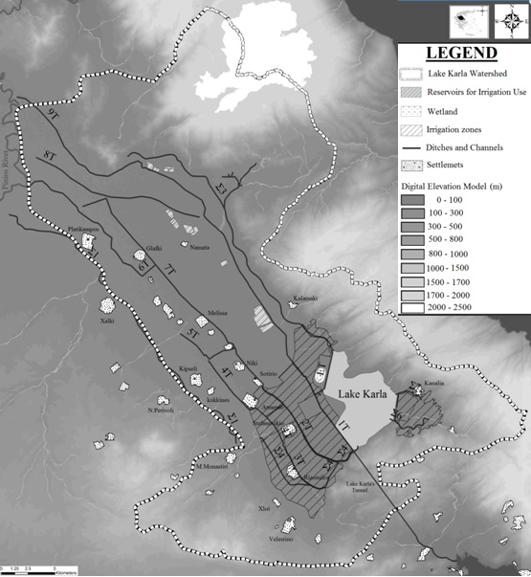
Hellenic Centre for Marine Research
Institute of Marine Biological Resources and Inland Waters
The restoration project of Lake Karla
Constructed within 2000-2010
Water is maintained through the construction of two 9 m-high dikes
Through pumping stations, drainage ditches and four rainwater collectors (Σ3, Σ4, Σ6, Σ7), surface runoff water from the higher elevation zones of the upper basin is diverted into the reservoir
90 hm³ of water are diverted into the lake in winter from Pinios through transport ditches (T)

Slide 6
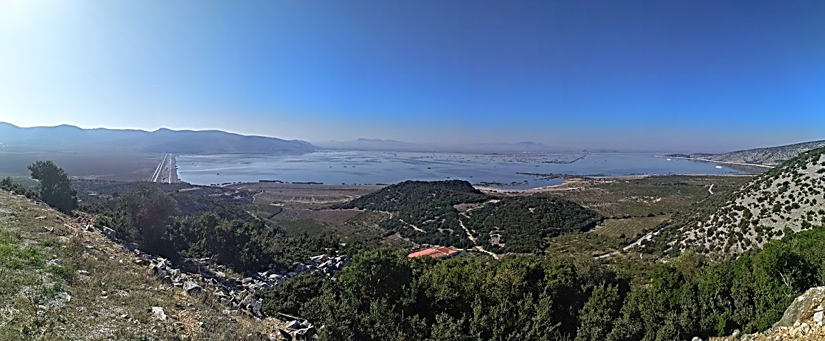
Hellenic Centre for Marine Research
Institute of Marine Biological Resources and Inland Waters
Project and Purpose
Surface area: 38 km²
Max storage: 180-200×10⁶ m³ (depth 4.5-5 m)
Min required storage: 100×10⁶ m³ (depth 2-2.5 m - ecological threshold)
Emergency spillway for floods
Targets:
Cover the irrigation needs of the surrounding cultivations in a max area of 90 km²
Transfer water to the Volos city to satisfy half of the total water supply needs
Enhance environmental restoration
Offer flood protection of the surrounding plain area
Facilitate the development of touristic activities

Slide 7
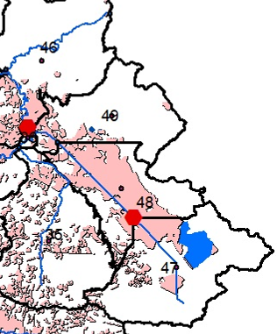
Hellenic Centre for Marine Research
Institute of Marine Biological Resources and Inland Waters
Operation, Water budget and crop yields (1)
Simulation with the SWAT model (https://swat.tamu.edu/)
Two scenarios:
With Lake Karla (nowadays)
Without Lake Karla (before 2000)
Model output | Scenario A: with Lake Karla | Scenario B: without Lake Karla
Area irrigated (subbasin 47, Figure 4) | 80 km² | 80 km²
Actual Irrigation water applied to the irrigated land of subbasin 47 | 500 mm of water or 40 hm³ of water extracted from Karla reservoir | 215* mm of water or 17.2 hm³ of water extracted from groundwater
Cotton yield (subbasin 47) | 4.89 t/ha or 39,120 t/y | 2.69 t/ha or 21,520 t/y
Pinios mean annual flow (outlet, subbasin 46) | 86.76 m³/s | 90.22 m³/s
*Due to water shortage in the Scenario B (no Karla), simulated groundwater abstractions for irrigation cannot reach the optimum level of 500 mm.

Slide 8
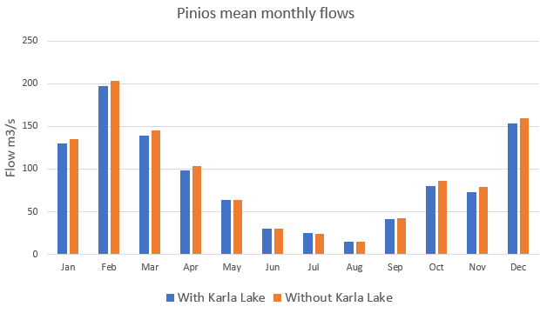
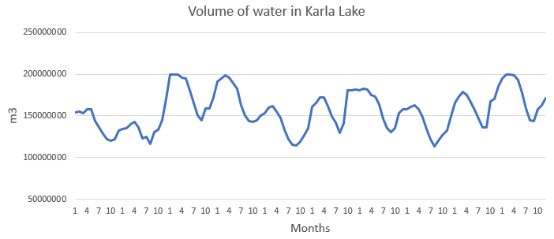
Hellenic Centre for Marine Research
Institute of Marine Biological Resources and Inland Waters
Operation, Water budget and crop yields (2)
Mean annual (2001-2010) water budget of Lake Karla as simulated in the scenario A (with Lake Karla)
 | Inflows (hm³) | Outflows (hm³)
Precipitation | 20 | 37 | Evaporation
Natural runoff | 25 | 33 | Seepage
Diversion from Pinios | 90 | 40 | Irrigation
 |  | 10 | Urban water supply
 |  | 15 | Overflows (sea)
Total | 135 | 135 | Total

Slide 9
Hellenic Centre for Marine Research
Institute of Marine Biological Resources and Inland Waters
Total Costs of the Project and Annual Equivalent Cost (AEC)
Cost types of the Lake Karla project | Cost in euros (€)
Design study of the project | 6,000,000
Expropriation of land | 46,500,000
Construction of the new lake along with the collector channels and man-made islands | 74,000,000
Formation of wetland and remaining works | 15,200,000
Works of diverting water from Pinios to Karla (pumping stations, ditches, channels) | 5,000,000
Works in Karla basin for the collection of runoff waters (collector channels etc) | 7,800,000
Water supply works from the lake to the city of Volos (pumping wells, transport network) | 9,500,000
Works associated with the development of rural tourism including environment and ecotourism promotion works, as well as the museum and information center | 5,600,000
Irrigation network cost (water transport and application) | 25,400,000
Archaeological investigations, start up of the Karla Management Body and technical advice | 19,000,000
Total | 214,000,000
Total (with VAT) | 245,000,000
Operational/Maintenance Cost (OMC) (% of Investment cost: 245 M€) | Interest Rate r (%) | AEC from Equation (1) (€)
1 | 2 | 10,000,000
2 | 2 | 12,700,000
3 | 2 | 15,000,000
1 | 3 | 12,000,000
2 | 3 | 14,400,000
3 | 3 | 16,900,000
1 | 5 | 15,900,000
2 | 5 | 18,300,000
3 | 5 | 20,800,000
For a lifespan n = 50 years

Slide 10
Hellenic Centre for Marine Research
Institute of Marine Biological Resources and Inland Waters
Cost Recovery
AEC = 15,000,000 €
The potential for cost recovery (annual pay back) is assessed through:
a volumetric pricing method for irrigation water (0.1 €/m³)
an urban water supply fee (1.2€/m³ with 0.6 €/m³ being retained locally)
a recreation fee (50 € / visitor)
direct economic benefits for the agricultural society (crop yield increase)
Return cost type | Calculation of return cost | Return cost
Irrigation | 5,000 m³/ha * 8,000 ha * 0.10 €/m³ | 4,000,000 €/y
Water supply Volos | 10 hm³ * 0.6 €/m³ | 6,000,000 €/y
Tourism | 20,000 visitors * 50€ | 1,000,000 €/y
 | Total | 11,000,000 €/y
Economic benefit type | Calculation of economic benefit | Economic benefit
Irrigation cost reduction | 500€/ha*8,000ha – 5,000 m³/ha * 8,000 ha * 0.10 €/m³ | 0
Productivity increase | [4.89 t/ha*400€/t – 2.69 t/ha*400€/t] * 8,000 ha | 7,040,000 €/y
 | Total | 7,040,000 €/y

Slide 11
Hellenic Centre for Marine Research
Institute of Marine Biological Resources and Inland Waters
Benefits – Ecosystem Services
Type of Ecosystem Service | Ecosystem Service | Description
Provisioning | Water for drinking purposes | provision of water for domestic uses (Volos city)
 | Water for non-drinking purposes | provision of water for agricultural uses (irrigation)
Regulation & Maintenance | Flood protection | trapping the runoff waters - avoid land inundation
 | Maintaining populations and habitats | habitats protecting from inundation habitats use as reproductive grounds, shelter for a variety of species
 | Soil formation and soil/subsoil composition | rich soil formation in wetland borders maintain soil fertility and stability all around the lake and resistance to saline water intrusion avoid salinization, avoid salt water intrusion in the subsoil enrich the aquifers increasing groundwater availability
Cultural | Recreation | recreational fishing, sightseeing, boating experiential interactions with nature recreation and mental and physical health tourism
 | Intellectual and aesthetic appreciation | intellectual and aesthetic interactions with nature aesthetic appreciation and inspiration for culture, art and design
 | Spiritual and symbolic appreciation | existence of emblematic species or sacred places spiritual and symbolic interactions with nature spiritual experience and sense of place

Slide 12
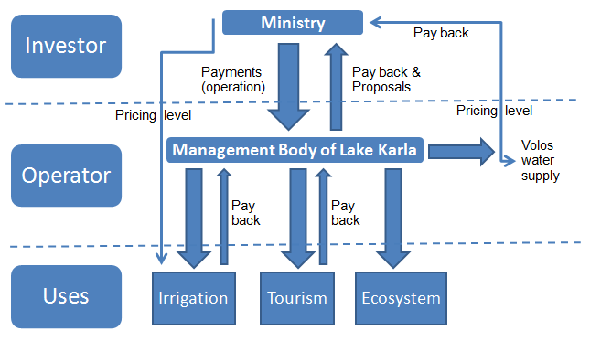
Hellenic Centre for Marine Research
Institute of Marine Biological Resources and Inland Waters
Governance and Management Plan
Investor: Ministry of Environment (setting the rules)
↕
Operator: Management authority of the Lake Karla NBS
operates the project by applying the rules, collects fees
responsible for the security of the project, the monitoring and environmental protection programs of the lake
Administrative Board:
Local municipalities
Regional Water Authority
Farmers union
Regional public authority
Environmental NGOs

Slide 13
Hellenic Centre for Marine Research
Institute of Marine Biological Resources and Inland Waters
Outcomes
Lake Karla’s water relies mainly on Pinios water diversions during the wet period of the year with quantities that are always guaranteed
Available irrigation water and crop productivity are almost doubled with Lake Karla
Irrigation cost for farmers with a volumetric pricing of 0.10€/m³ of Karla’s water is the same with no Karla existence
Individual farmer’s income increase is estimated as ~4,000€ or 20-25%
No concerns on water availability → direct (economic) and indirect (emotional) benefits → Quality of life
The wider agricultural floodplain around Karla is highly protected from inundation → flooded waters are trapped in the Karla reservoir
Groundwater balance results to an estimated 50 hm³ increased annual recharge with Lake Karla in place → increase waters in the nearby Intermittent/ephemeral streams and allow cost-effective groundwater pumping for other water uses

Slide 14
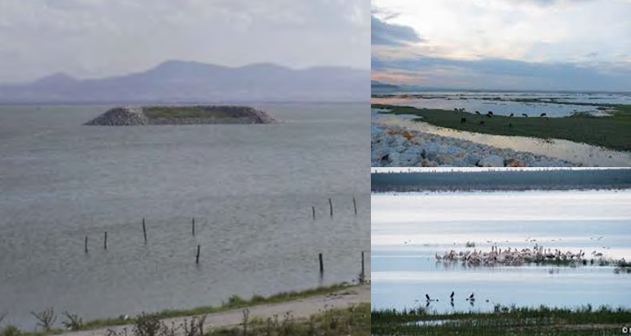
Hellenic Centre for Marine Research
Institute of Marine Biological Resources and Inland Waters
Outcomes
Ecological benefits → Tourism opportunities (hiking, biking, birdwatching) and cultural services (museums and educational sites)
Sociology: Reduction of unemployment and welfare increase → Agricultural population maintenance / Motivation for population return → feeling of optimism to the new generations
Biodiversity enhancement: Numerous birds and six fish families/thirteen species
Designated as Natura 2000 and Ramsar site

