Slide 1
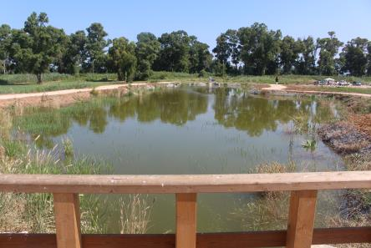
NATURE-BASED SOLUTIONS
FOR CLIMATE CHANGE ADAPTATION
AND WATER POLLUTION IN AGRICULTURAL REGIONS
Lot 6
LDP in a Mediterranean Environment Feasibility Study
Dr. Fabio Masi 05th May 2020
www.iridra.com
info@iridra.com

Slide 2
Objectives
The present study aims to contribute to the reduction of agricultural water pollution by Nature-Based Solutions (NBS) while delivering, at the same time, other benefits beyond water pollution control, such as shelters for biodiversity, amenity and recreational opportunities.
More specifically the present study will provide evidence to address the following questions:
How can NBS contribute to mitigate agricultural water pollution (nutrients, pesticides, sediments, and other contaminants)?
What are the costs and cost drivers of NBS?
What are the benefits they deploy?
What are the technical, capacity, governance, management and financial constraints hampering their take-up?

Slide 3
Study Area
The heavy landscape transformation caused by the “Great Land Reclamation” of the 1920s, and the industrial and residential development in the Agro Pontino led to a progressive pollution of surface and ground water and a growing artificiality of the landscape with important losses in terms of ecosystem services
The Life+ REWETLAND project, coordinated by the Province of Latina, aimed to spread NBSs to control diffuse pollution, and thus improve the quality of the surface waters of the Agro Pontino.
The project led to the drafting of an Integrated Environmental Restoration Program (ERP) of the Pontine Plain, that identifies several NBS typologies that should be promoted on an area of about 700 km², entailing a network of 220 km of drainage channels.

Slide 4
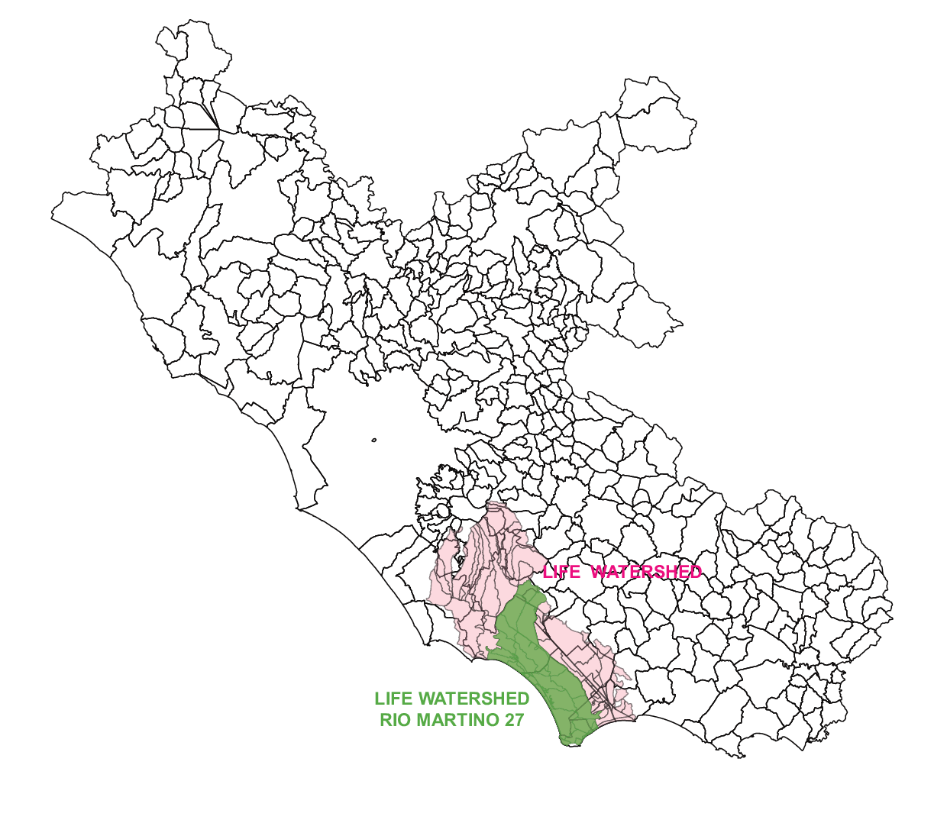
Study Area
The “Agro Pontino” (Latina Province), is an intensive farming and livestock area located in Central Italy where a few NBS for diffuse pollution control have recently been implemented through a Life+ project
The Ecology and Environment Sector of the Province of Latina has elaborated in 2009 a detailed analysis of the hydrographic basins on its territories , which have been divided in main basins and smaller sub-basins.
Figure 1. Geographical localization of the watershed of interest of the LIFE+ REWETLAND

Slide 5
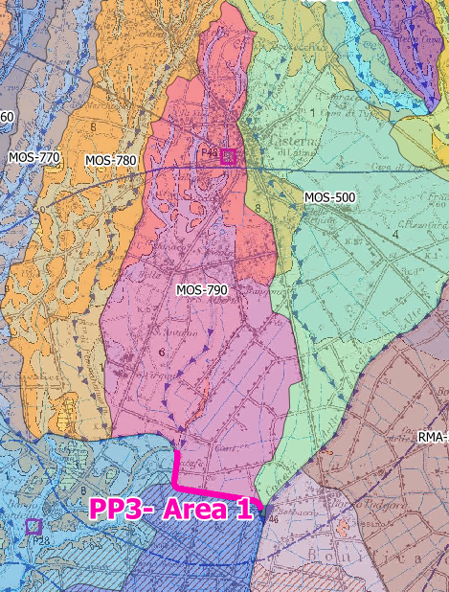
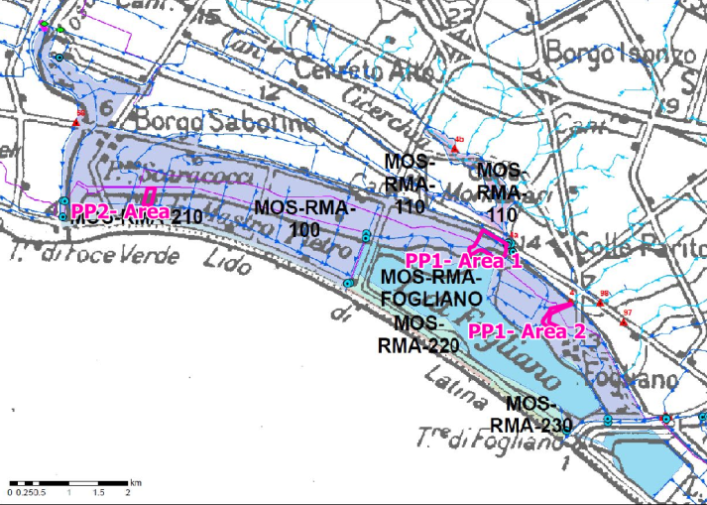
Study Area
The present study is focused on three NBSs, implemented in 2014, that are included in the following basins:
PP1, Villa Fogliano and Pantano Cicerchia
Main basin: MOS-RMA; Sub-basins: MOS-RMA-100 and MOS-RMA-110
PP2, Marina di Latina
Main basin: MOS-RMA; Sub-basins: MOS-RMA-100
PP3, Allacciante canal
Main basin: MOS; Sub-basins: MOS-790
Figure 2. Maps of the sub-basins under study

Slide 6
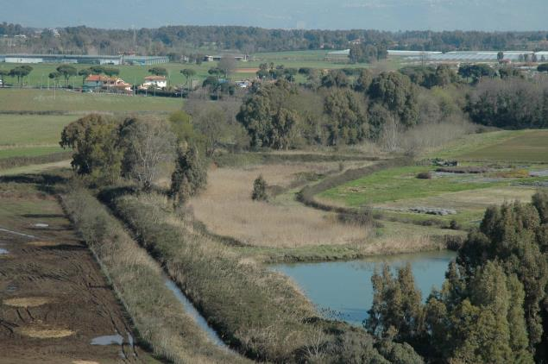
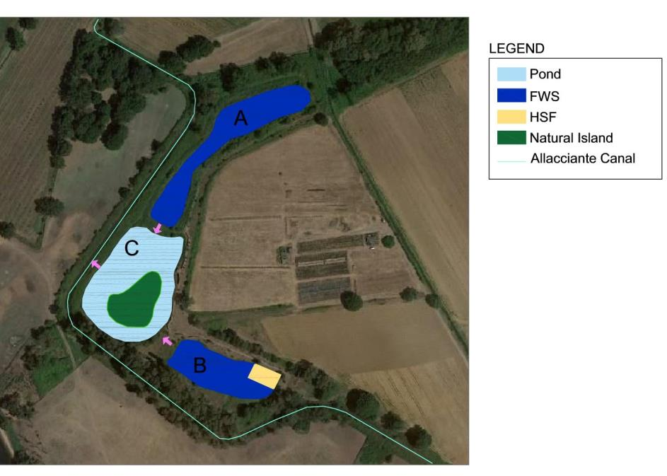
Wetlands
VILLA FOGLIANO (5 ha):
It is an off-line wetland receiving the water from the Rio Martino stream.
It is characterized by three basins (A, B and C) but only basin A has been considered by the present study.
The a surface flow system (FWS) treats the outflow from the Rio Martino – Foce Verde Canal (in summer) and from Allacciante Canal (in winter).
Figure 3. Picture of Basin A (Source: LIFE+ REWETLAND)
Figure 4. Planimetry of the Villa Fogliano wetland

Slide 7
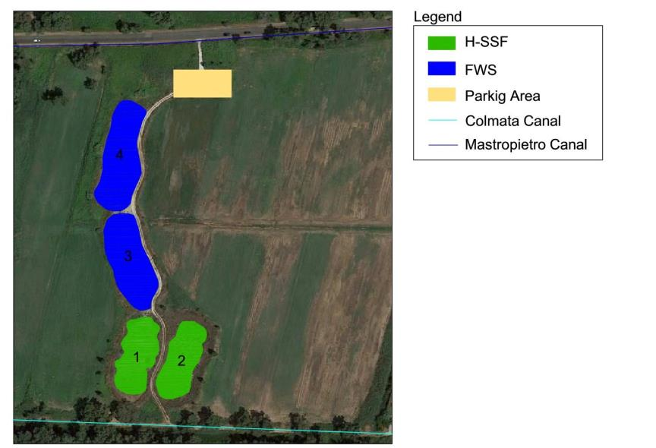
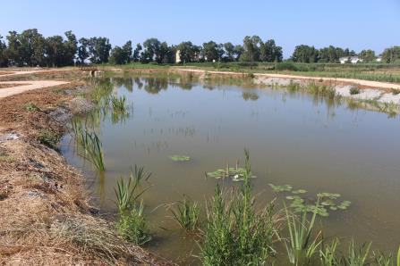
Wetlands
MARINA DI LATINA (0.4 ha):
The CW is a hybrid system: 1st stage, horizontal subsurface flow (HF) constructed wetland, with 2 beds in parallel; 2nd stage, 2 free water surface (FWS) basins in series.
The wetland is fed by the water coming from the Comata Canal; after the treatment, the water is discharged into the Mastro Pietro Canal
Figure 6. Pictures of the Salzano wetland from the site visit held the 17th September 2019.
Figure 7. Planimetry of the Marina di Latina wetland

Slide 8
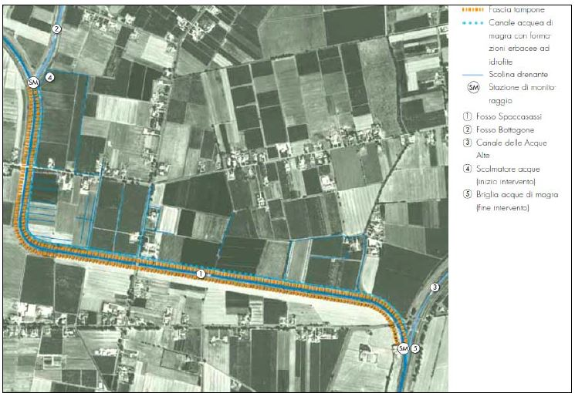
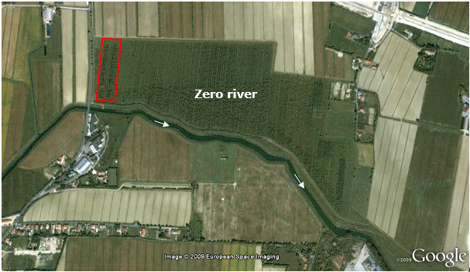
Buffer Strips
ALLACCIANTE ASTURA Buffer strip (2.2 ha):
It is a 3.7 km long and 6 m wide buffer strip, that includes both trees and shrubs.
The BS was placed along the left bank of the Spaccasassi Ditch (Astura Allacciante Canal CAA), in the stretch between the confluence of the Bottagone Ditch and the confluence of the CAA in the Acqua Alta Canal
Figure 8. Aerial view of the whole (30 ha) afforested riparian buffer area, located in the left bank of the Zero river. The red area includes the NICOLAS experimental site (0.85 ha).
Figure 9. Plan of the Buffer Strip (in orange) of the Allacciante Astura Canal (in light blue).

Slide 9
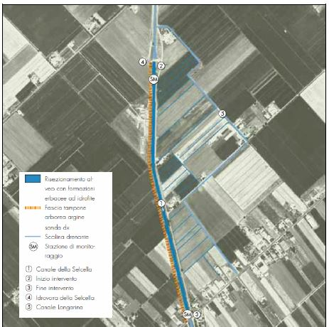
Buffer Strips
SELCELLA CANAL:
6 meters wide buffer strip along the right bank of the Selcella Canal, planted with trees and shrubs
to enhance the self purification capacity of the Selcella canal, both emergent macrophites and submerged hydrophytes have been planted in the canal section.
the Selcella canal buffer strip has an average slope of 38%, way higher than the range found in literature. Therefore, it was decided not to analyse the removal efficacy of the Selcella canal buffer strip.
Figure 10. Plan of the Buffer Strip (in orange) of the Selcella Canal (in light blue).

Slide 10
Results
Each NBS is described in terms of its design (layout, illustrative design drawings such as cross sections or sketches)
Several monitoring campaigns on the NBS have provided data on their removal effectiveness, however the monitoring protocol does not fit with the aims of the present study.
To provide suitable data for the watershed analysis of chapter 6, a theoretical estimation of the treatment performance of the REWETLAND NBS sites was proposed
Where lacking, the removal effectiveness were estimated by using the data from the literature.

Slide 11
Results
 | Areal removal capacity of NBS [g m⁻² y⁻¹] or percentage removal
 | TN | TP | Glyphosate
Villa Fogliano | 2 | 0.2 | 0.1
Marina di Latina | 20 | 1.1 | 4
Allacciante canal | 28.8 | 1.1 | 0.2
Table 1. The table shows the removal capacities of the NBS given in g m⁻² y⁻¹

Slide 12
COST ANALYSIS
The investment costs of the NBS have been estimated on the basis of the financial framework of the detailed design delivered for their construction year
O&M have been detailed with interviews to the staff of the management Authority
 | Working costs | Investment costs | O&M costs
 | € m⁻² | € m⁻² | € m⁻² y⁻¹
Villa Fogliano | 4.54 | 6 | 0.26 – 0.61
Marina di Latina | 117.84 | 139.7 | 0.26 – 0.61
Allacciante canal | 11 |  | 0.42
Selcella canal | 48 |  | 0.42
Table 2. The table shows the investment costs and O&M costs of wetlands and buffer strips and their estimations for the whole sub-basins.
* Higher values correspond to CWs waterproofed with plastic liner, as in Rizzo et al. (2018)

Slide 13
Social Analysis
General Objective
Specific Objectives
Explore the main issues affecting social sustainability of the study area
Identify and evaluate the capacity of the case as local development success model
Study the main relations among relevant stakeholders and their perceptions about NBS
Collecting and analysing the issues affecting the social sustainability of the application of a NBS in in the Watershed of Agro Pontino.

Slide 14
Quantification of Direct and Indirect Benefits
Costs and benefits identified have been quantified using specific indicators
Estimation of the performance of each NBS to compare different NBSs.
Valuation of non-monetary benefits through appropriate value transfer methods
for a general assessment of the benefits provided to the study area.
BENEFITS
Improved water quality
Recreation and health
Education
Flooding Risk
Biodiversity
NBS contribute to flood risk reduction
Wetlands aquatic Habitat provide higher biodiversity compared to buffer strips
Natural areas appreciated by schools
NBS provide a recreational service for the local population

Slide 15
Quantification of Direct and Indirect Benefits
Objectives/criteria | Indicators and units of measure to compare each NBS performance | Range of monetary values by value transfer [€/year] SCENARIO 1 | Range of monetary values by value transfer [€/year] SCENARIO 2
Reduce flood risk | Peak flow reduction (retention volume) m³ | 0 | 41,580.00 - 76,134.00
Use for recreation | Accessibility: no. of people leaving in a range of 1 Km from the NBS (potential recreation users) | 1,555,523 – 1,728,200 | 2,798,513 - 4,214,181
Use for education | Expert judgement based on 3 classes: NBS not used for educational purposes NBS used for educational purposes by the Drainage Authority NBS used for educational purposes by the Drainage Authority and by NGOs Dimensionless, ranging from 0 to 2 | 59,400 - 132,000 | 59,400 - 132,000
Contribute to water quality | Nitrogen removal: t_{N}/year | 18,869.00 - 37,737.00 | 1,240,588.00 - 3,883,715.00
 | Phosphorus removal: t_{P}/year
 | Sediment removal: t_{TSS}/year
 | Pesticide removal: t_{glyphosate}/year
Support biodiversity | Expert judgment, based on the size of the NBS Dimensionless, ranging from 0 to 1 | 8,291.00 – 10,292.00 | 187,807.00 - 209.844.00
CAPEX | € | 0 | 80,141,240.00
OPEX | €/year | 0 | 1,773,896.80
Loss of farmland income | €/year | 0 | 480,847.44
Table 3. The table sum up the benefits and the related monetary values quantified in the present study.

Slide 16
Business Model Analysis
The background idea of the Rewetland project was to realize some demonstration NBS, showing to the local people that they could provide benefits, develop a program (the ERP) to replicate the NBS at larger scale, find the financial resources to implement NBS at large scale through the ordinary funding channels. This business model failed for two reasons:
the lack of knowhow transfer and capacity building towards a key actor: the Consorzio di Bonifica Agro Pontino;
the lack of financial resources through ordinary channels to replicate the NBS realization at larger scale.
The Greenchange business model is based on entrusting farms with state-owned areas bordering waterways for the construction and management of NBSs (typically linear arboreal/shrub formations or wetlands) whose primary objective is to support biodiversity, but which also perform a function of reducing diffuse pollution.
The condition for this business model to be replicable is the availability of public land properly located to allow the realisation of NBS effective for diffuse pollution removal

Slide 17
Conclusions
In conclusion:
The analysed case study provides several useful hints, even though it does not always allow clear answers to all the questions that are the objective of the present study
Pollutant removal capacity in the range expected according to scientific literature but lower than the most performing existing case studies
Reasonable construction and O&M costs
two scenarios were envisaged to assess direct and indirect costs and benefits, both scenarios do not excel in term of diffuse pollution reduction
High value provided by the NBS every year for the community
The Greenchange project developed an effective business model based the enhancement of state-owned areas

Slide 18
NATURE-BASED SOLUTIONS
FOR CLIMATE CHANGE ADAPTATION
AND WATER POLLUTION IN AGRICULTURAL REGIONS
Lot 6 : LDP in a Mediterranean Environment Feasibility Study
Thank you for your attention!
www.iridra.com
info@iridra.com
Dr. PhD FABIO MASI

